Slide 1
CHAPTER - 3
Data and Signals
Part-1

Slide 2
Data and Signal
Data: It is any set of characters that has been gathered and translated for some purpose, usually analysis. It can be any character, including text and numbers, pictures, sound, or video.
  Example: Mamun, 234.
Signal: It is electrical, electronic or optical representation of data, which can be sent over a communication medium.
To be transmitted, data must be transformed to electromagnetic signals.

Slide 3
3.1 Analog and digital
Both data and the signals can be analog or digital.
Analog data refers to information that is continuous.
Analog data take on continuous values.
  For example, analog data, such as the sounds made by a human voice, take on continuous values. When someone speaks, an analog wave is created in the air. This can be captured by a microphone and converted to an analog signal or sampled into a digital signal.

Slide 4
Cont.
Digital data refers to information that has discrete states.
Digital data take on discrete values.
  For example, data are stored in computer memory in the form of 0s and 1s. They can be converted to a digital signal or modulated into an analog signal for transmission across a medium.

Slide 5
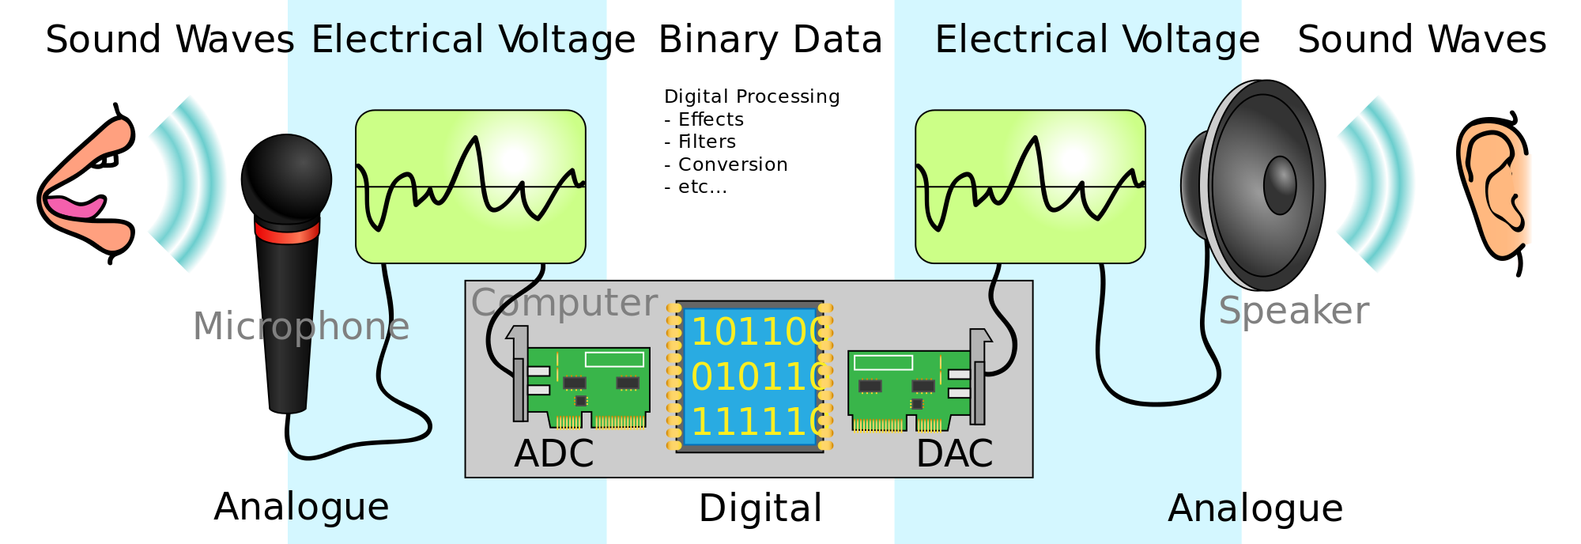
Cont.

Slide 6
Analog and Digital Signals
Analog signal:
  It is a continuous wave form that changes smoothly. As the wave moves from a value A to a value B, it passes through and includes an infinite number of values along its path.
    Denoted by sine waves.
Digital signal:
  It can have only a limited number of defined values, often as simple as 1 and 0.
    Denoted by square waves.

Slide 7

Cont.
Analog signals can have an infinite number of values in a range; digital signals can have only a limited number of values.

Slide 8
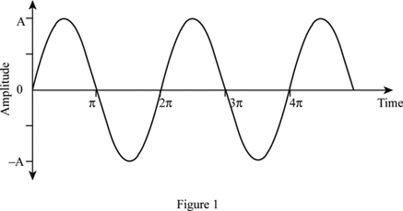
Periodic and Nonperiodic Signals
Both analog and digital signals can take one of two forms: (1). periodic (2). Nonperiodic.
Periodic signal:
  It completes a pattern within a measurable time frame, called a period, and repeats that pattern over subsequent identical periods. The completion of one full pattern is called a cycle.

Slide 9
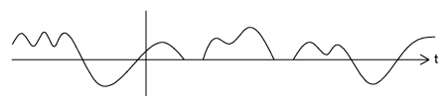
Periodic and Nonperiodic Signals
Nonperiodic signal:
  It changes without exhibiting a pattern or cycle that repeats over time.

Slide 10
Cont.
Both analog and digital signals can be periodic or nonperiodic.
In data communications, we commonly use periodic analog signals (because they need less bandwidth) and nonperiodic digital signals (because they can represent variation in data).

Slide 11
3.2 Periodic analog signals
Periodic analog signals can be classified as simple or composite.
  A simple periodic analog signal, a sine wave, cannot be decomposed into simple signals.
  A composite periodic analog signal is composed of multiple simple signal (sine waves).

Slide 12

Sine Wave
The sine wave is the most fundamental form of a periodic analog signal.
A sine wave can be represented by three parameters:
(1). Peak amplitude (2). Frequency (3). Phase.
These three parameters fully describe a sine wave.
Figure 3.2 A sine wave

Slide 13

Cont.
Peak Amplitude
The peak amplitude of
a signal is the absolute
value of its highest intensity, proportional to the energy it carries.
For electric signals,
peak amplitude is normally measured in volts.

Slide 14
Cont.
Period and Frequency:
Period refers to the amount of time, in seconds, a signal needs to complete 1 cycle.
Frequency refers to the number of periods during a specific time interval.
Period is the inverse of frequency, and frequency is the inverse of period, as the following formulas show.
f= 1/T and T=1/f
Frequency and period are the inverse of each other.

Slide 15

Cont.
Figure 3.4 Two signals with the same amplitude and phase, but different frequencies

Slide 16


Cont.
Period is formally expressed in seconds.
Frequency is formally expressed in Hertz (Hz), which is cycle per second.
Table 3.1 Units of period and frequency
Unit | Equivalent | Unit | Equivalent
Seconds (s) | 1 s | Hertz (Hz) | 1 Hz
Milliseconds (ms) | 10⁻³ s | Kilohertz (kHz) | 10³ Hz
Microseconds (µs) | 10⁻⁶ s | Megahertz (MHz) | 10⁶ Hz
Nanoseconds (ns) | 10⁻⁹ s | Gigahertz (GHz) | 10⁹ Hz
Picoseconds (ps) | 10⁻¹² s | Terahertz (THz) | 10¹² Hz

Slide 17
Cont.
Example 3.3
The power we use at home has a frequency of 60 Hz (50 Hz in Europe). The period of this sine wave can be determined as follows:
T=1/f=1/ 60 = 0.0166 s = 0.0166 x 10³ ms =16.6 ms
This means that the period of the power for our lights at home is 0.0116 s, or 16.6 ms. Our eyes are not sensitive enough to distinguish these rapid changes in amplitude.

Slide 18
Cont.
Phase
The term phase describes the position of the waveform relative to time 0.
Phase is measured in degrees or radians. [360° is 2 π rad, 1° is 2π/360 rad, and 1 rad is 360/(2π)].
  A phase shift of 360° corresponds to a shift of a complete period.
  A phase shift of 180° corresponds to a shift of one-half of a period.
  A phase shift of 90° corresponds to a shift of one-quarter of a period.

Slide 19

Cont.
Figure 3.5 Three sine waves with the same amplitude and frequency,
but different phases

Slide 20
Cont.
Example 3.6:
A sine wave is offset 1/6 cycle with respect to time 0. What is its phase in degrees and radians?
Solution
We know that 1 complete cycle is 360°. Therefore, 1/6 cycle is
(1/6) *360=60°=60*(2π/360) rad=π/3 rad =1.046 rad

Slide 21
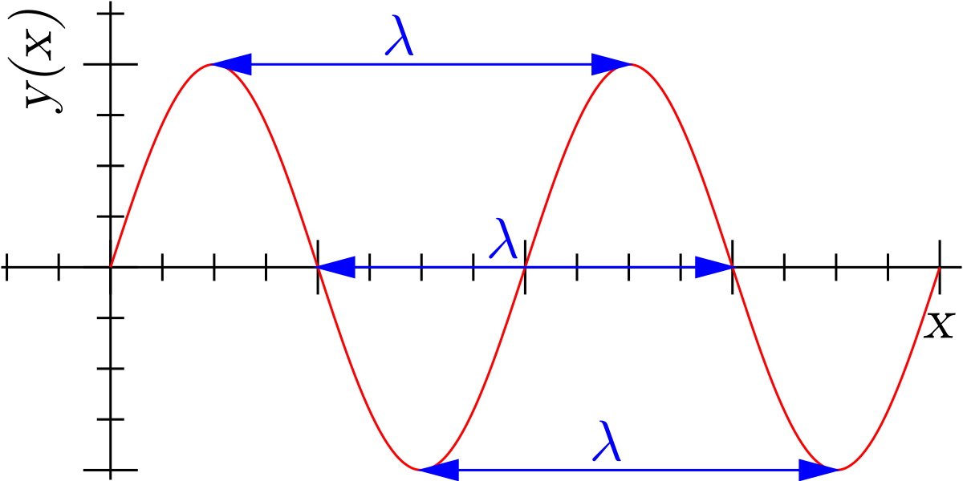
Cont.
Wavelength
  The wavelength is the distance a simple signal can travel in one period.

Slide 22
Cont.
Wavelength = Propagation speed x period
λ = c x T
Or = Propagation speed/frequency
λ = c / f
f= 1/T and T=1/f

Slide 23
Cont.
For example, in a vacuum, light is propagated with a speed of 3 x 10⁸ m/s. That speed is lower in air and even lower in cable.
The wavelength is normally measured in micrometers (microns) instead of meters.
For example, the wavelength of red light (frequency =4 x10¹⁴) in air is
λ = c/ f = 3x10⁸/4 x10¹⁴ =0.75 x 10⁻⁶m=0.75 µ m

Slide 24
Composite Signals
If we had only one single sine wave to convey a conversation over the phone, it would make no sense and carry no information. We would just hear a buzz. We need to send a composite signal to communicate data.
A composite signal is made of many simple sine waves.
A single frequency sine wave is not useful in data communications;
we need to send a composite signal, a signal made of many simple sine waves.
According to Fourier analysis, any composite signal is a combination of simple sine waves with different frequencies, amplitudes, and phases.

Slide 25
Cont.
A composite signal can be periodic or nonperiodic.
  A periodic composite signal can be decomposed into a series of simple sine waves with discrete frequencies-frequencies that have integer values (1, 2, 3, and so on).
  A nonperiodic composite signal can be decomposed into a combination of an infinite number of simple sine waves with continuous frequencies, frequencies that have real values.
If the composite signal is periodic, the decomposition gives a series of signals with
discrete frequencies; if the composite signal is nonperiodic, the decomposition
gives a combination of sine waves with continuous frequencies.

Slide 26

Cont.
Bandwidth:
The bandwidth of a composite signal is the difference between the highest and the lowest frequencies contained in that signal.

Slide 27
Cont.
Example 3.10
If a periodic signal is decomposed into five sine waves with frequencies of 100, 300, 500, 700, and 900 Hz, what is its bandwidth? Draw the spectrum, assuming all components have a maximum amplitude of 10 V.
Solution:
Let f_{h} be the highest frequency, f_{l} the lowest frequency, and B the bandwidth. Then
B =f_{h} - f_{l} = 900 - 100 =800 Hz

Slide 28

Cont.
The spectrum has only five spikes, at 100, 300, 500, 700, and 900 Hz.
Figure 3.13 The bandwidth for Example 3.6

Slide 29
3.3 Digital signals
In addition to being represented by an analog signal, information can also be represented by a digital signal.
  For example, a 1 can be encoded as a positive voltage and a 0 as zero voltage.
A digital signal can have more than two levels. In this case, we can send more than 1 bit for each level.
    Number of bits required per level=log₂ L bit
L= Level

Slide 30

Cont.
Figure 3.16 Two digital signals:
one with two signal levels and the Other with four signal levels.
Number of bits required per level
=log₂ L bit
=log₂ 4
= 2

Slide 31
Cont.
Example 3.16
  A digital signal has eight levels. How many bits are needed per level? We calculate the number of bits from the formula.
    Number of bits per level=log₂ 8 =3
    Each signal level is represented by 3 bits.

Slide 32
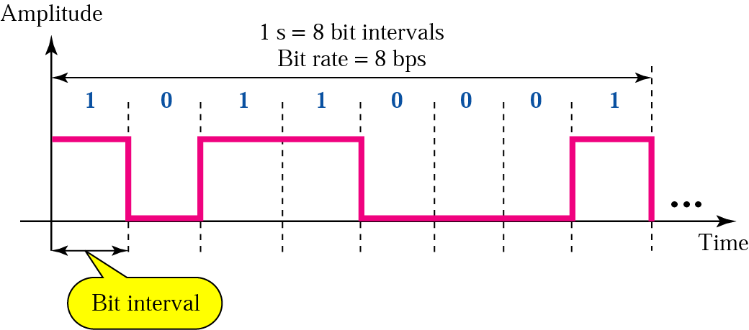
Cont.
Bit Rate:
  The bit rate is the number of bits sent in 1s, expressed in bits per second (bps).

Slide 33
Cont.
Example 3.18
  Assume we need to download text documents at the rate of 100 pages per second. What is the required bit rate of the channel?
Solution:
  A page is an average of 24 lines with 80 characters in each line. If we assume that one character requires 8 bits, the bit rate is
  100 x 24 x 80 x 8 =1,536,000 bps =1.536 Mbps

Slide 34
Cont.
Bit Length:
The wavelength used for an analog signal: The distance one cycle occupies on the transmission medium.
We can define something similar for a digital signal: the bit rate
The bit length is the distance one bit occupies on the transmission medium.
  Bit length = bit duration x propagation speed
  = bit width x propagation speed
  = (sec) x (meters/sec)
  = (meters)

Slide 35
Cont.
Transmission of Digital Signals:
The fundamental question is, How can we send a digital signal from point A to point B?
We can transmit a digital signal by using one of two different approaches:
    (1). Baseband transmission
    (2). Broadband transmission (using modulation).

Slide 36

Cont.
Baseband Transmission:
  Baseband transmission means sending a digital signal over a channel without changing the digital signal to an analog signal.
Figure 3.18 Baseband transmission

Slide 37
Cont.
Baseband transmission requires that we have a low-pass channel, a channel with a bandwidth that starts from zero. This is the case if we have a dedicated medium with a bandwidth constituting only one channel.
  For example, the entire bandwidth of a cable connecting two computers is one single channel.
  Another example, we may connect several computers to a bus, but not allow more than two stations to communicate at a time.

Slide 38

Cont.
Figure 3.19 Bandwidths of two low-pass channels

Slide 39

Cont.
Broadband Transmission (Using Modulation):
Broadband transmission or modulation means changing the digital signal to an analog signal for transmission. Modulation allows us to use a bandpass channel-a channel with a bandwidth that does not start from zero. This type of channel is more available than a low-pass channel.
Figure 3.23 Bandwidth of a bandpass channel

